Slide 1
Data Warehouse Concepts Part 2
<Data Warehouse101 Series>
Anand Kumar
Notes:
‹#›
Hi. This is part 2 of the DWH Concepts presentation series
In this module we shall cover the basics of Data Warehousing Concepts.
Let us begin our session with an outline of Data Warehousing.
Confidential © 2008 Wipro Ltd
‹#›

Slide 2
Data Warehouse Concepts Overview
Data Warehouse Concepts Part 1 covers ,
The definition of Data Warehouse
The need for the Data Warehouse
Difference between Transaction Processing and Query Processing
Definition of Data Mart
Data warehouse Concepts Part 2 covers,
Definition of ODS
Data Warehouse architecture
Data Warehouse tools
Notes:
Data warehouse contains data which is used for query and analysis purpose. For e.g.
-The users might want to know the amount of HP Desktop sales that happened in Bangalore for last 5 years.
- How much has laptop sales grown in last 5 years?
- What promotions have satisfied the customers and thus helped in increase of sales volume?
These questions, search data from last several years and find the details. So data warehouse mostly contains historical data and operate upon those data to generate reports and help analytical queries. It is different from transaction processing since it does not contain a lot of updates and deletes. There may not be many active users for data warehouse who will like to run analytical queries but there are many users who will get the reports generated by the data warehouse system.
The other important aspects attached with data warehouse is ETL (extract, transform and load) and reporting tools apart from the different database design (different than transactional system) . The ETL and reporting tools play an important role as they provide easy to use GUI enabled, drop down features to develop data transfer process and multiple types of reports, dashboards in a very short span of time.
This presentation is part 2 of the series.
This module covers following Topics of Data Warehousing Concepts .
The definition of Operational data store
2) The architecture of Data Warehouse
3) The Data Warehouse Components
© 2009 Wipro Ltd – Internal & Restricted
‹#›

Slide 3
Data Warehouse Concepts Objectives
Upon completion of this module you will be able to:
Understand the ODS
Understand the Warehouse Architecture
Understand the Warehouse Components
Notes:
As we know that the data warehouse system has multiple components.
Here we will try to understand what these different components are.
Objectives of this module are to:
Understand what is ODS
Understand the Warehouse Architecture
Understand different Warehouse Components
Operation Data Store is the place where most of the data used in current operation is housed before it's transferred to the data warehouse for longer term storage. It is similar to your short term memory in that it stores only very recent information; in comparison, the data warehouse is more like long term memory in that it stores relatively permanent information. We will cover definition and different characteristics of Operational Data store in first section of this module.
There are many variations of Data warehousing Architecture defined after understanding different business requirements and technical feasibility of proposed solutions for the business requirements .
In second section we will have a look into most widely used Architectures of Data Warehouse.
In the process of building a Data Warehouse we use different tools like ETL Tool, Data Modelling tool, Data Cleansing Tool, Reporting Tool etc. for different purposes. These tools help in reducing the development life cycle and provides maintainability of the Warehouse.
In last section of this presentation we will cover different characteristics of these Data Warehouse tools.

Slide 4
Outlines
Lesson 1 Operational Data Stores
Lesson 2 Warehouse Architecture
Lesson 3 Warehouse Components
Notes:
‹#›
This is the second part of the data warehouse concepts series.
It has 3 Lessons.
1st lesson is Operational data store in which we will understand what is ODS and how it differs from DWH and OLTP.
2nd lesson is Warehouse architecture, It covers typical Warehouse Architecture.
and 3rd lesson is Warehouse components. This lesson covers an overview of different components of Warehouse.

Slide 5
Operational Data Store
Its characteristics & Different kinds of Information Needs
Notes:
‹#›
We shall now start with the first lesson i.e. Operational Data Store
In this lesson we are going to cover :
-The characteristics of ODS
-The type of information kept in ODS
-The difference among OLTP (on line transaction processing) , ODS (operational data store ) and DWH (data warehouse).
An operational data store (ODS) is a type of database that's often used as an interim logical area for a data warehouse .
It can be used for integrating disparate data from multiple sources so that business operations, analysis and reporting can be carried out while business operations are occurring. This is the place where most of the data used in current operation is housed before it's transferred to the data warehouse for longer term storage or archiving.
An ODS is designed for relatively simple queries on small amounts of data (such as finding the status of a customer order), rather than the complex queries on large amounts of data typical of the data warehouse.

Slide 6
Operational Data Store
The ODS applies only to the world of operational systems.
The ODS contains current valued and near current valued data.
The ODS contains almost exclusively all detail data
The ODS requires a full function, update, record oriented environment.
Notes:
‹#›
Below are the few characteristics of Operation Data store :
-ODS applies only to the world of operational systems - ODS tend to be more reflective of source structures in order to speed implementations and provide a truer representation of operational system’s data.
-It contains current valued and near current valued data - It contains limited history that is captured "real time" or "near real time" as opposed to the much greater volumes of data stored in the Data warehouse generally on a less frequent basis.
-It contains almost exclusively all detail data. It is usually designed to contain low level or atomic (or indivisible) data (such as transactions and prices)
-It requires a full functioning, update record oriented environment. It is implemented on top of operational OLTP applications. It is some times implemented as replica of OLTP source.

Slide 7
Different kinds of Information Needs
Current
Recent
Historical
Is this medicine available in stock
What are the tests this patient has completed so far
Has the incidence of Tuberculosis increased in last 5 years in Southern region
OLTP
ODS
Data Warehouse
Notes:
‹#›
From this slide, you can understand the difference among OLTP (on line transaction processing) ODS (operational data store ) and DWH (data warehouse. What we see here is the different kinds of information needs catered by OLTP,ODS and DWH, depicted by an example for each.
As a current information need if one asks a question “Is this medicine available in stock ?” , The OLTP provides answers (yes or no).
ODS provides recent data. For e.g. The tests a patient has completed so far. It does not tell if a medicine is available now for a patient or not.
A Data warehouse provides historical data. For e.g. Has the incidence of Tuberculosis increased in last 5 years in Southern region? Here the time period is quite long.

Slide 8
OLTP Vs ODS Vs DWH
Characteristic | OLTP | ODS | Data Warehouse
Audience | Operating Personnel | Analysts | Managers and analysts
Data access | Individual records, transaction driven | Individual records, transaction or analysis driven | Set of records, analysis driven
Data content | Current, real-time | Current and near-current | Historical
Data Structure | Detailed | Detailed and lightly summarized | Detailed and Summarized
Data organization | Functional | Subject-oriented | Subject-oriented
Type of Data | Homogeneous | Homogeneous | Vast Supply of very heterogeneous data
Notes:
‹#›
Comparison of OLTP,ODS and DWH is done based on characteristic parameters.
The various characteristics used for comparison are:
Audience, Data access, Data content, Data structure, Data organization, Type of data, Data redundancy, Data update, Database size, Development methodology and Philosophy.
The target audience for each of these three are different
OLTP is for Operating Personnel, ODS is for Analysts and Data Warehouse is for Managers and analysts.
The data warehouse data is used for e.g. to see how the sales are happening over the years or across various regions and so suits Managers in that it helps them analyze the business.
The operating personnel has nothing to do with analysis of sales over the years or across the regions. He is more concerned with insert / update / delete of records for e.g. order record or purchase record.
Data access method for OLTP,ODS & DWH also differ:
-In OLTP, data is transaction driven, more concerned with individual records.
-In ODS, it is individual records and transaction or analysis driven.
-In Data warehouse, it is set of records and analysis driven.
‘transaction driven’ refers to insert/update/ and delete of individual records while analysis driven refers to applying sum, average, min ,max functions over a set of records. For e.g. a sales operator will insert a transaction of grocery item into the system. The analyst/manager will sum the total sale or average of sale (analysis driven) at multiple locations of the sales depot to gauge the amount of sales.
In OLTP the data content is current and real-time. In ODS it is current and near current. In Data Warehouse it is historical.
In OLTP the data structure is detailed (most of the attributes of an entity type is used) for e.g. to view a customer detail. In ODS it is detailed and lightly summarized. In Data warehouse it detailed and summarized.
In OLTP the data is organization is functional like order entry function, purchasing function etc. In ODS and Data warehouse it is subject oriented like customers, orders, purchases etc.
OLTP is for an operational application (homogeneous data). Homogeneous means data from same functional area. For e.g. a purchase department has its own database system, an inventory department has its own database system. Purchase department may record Customer phone no. as (area code) phone no. e.g. (011) 212211 while the inventory department can record the same in a different format like area code-phone e.g. 011-212211. All the functions of purchase department will use phone no. format as (011) 212211 while that of inventory functions will use 011-212211.
ODS is for a source system (data is not integrated across source systems in ODS hence captures homogeneous data from a source system)
DW integrates data from multiple internal and external source systems and hence will capture heterogeneous data across multiple sources.
For e.g. As mentioned in the example it will use phone no format from purchase and inventory departments which are different (heterogeneous data).

Slide 9
OLTP Vs ODS Vs DWH
Characteristic | OLTP | ODS | Data Warehouse
Data redundancy | Non-redundant within system; Unmanaged redundancy among systems | Somewhat redundant with operational databases | Managed redundancy
Data update | Field by field | Field by field | Controlled batch
Database size | Moderate | Moderate | Large to very large
Development Methodology | Requirements driven, structured | Data driven, somewhat evolutionary | Data driven, evolutionary
Philosophy | Support day-to-day operation | Support day-to-day decisions & operational activities | Support managing the enterprise
Notes:
‹#›
Some more comparisons of OLTP,ODS and DWH is shown here.
-Data Redundancy
OLTP is normalized and no data redundancy within OLTP application. But across applications, data duplication / redundancy is not managed. Each OLTP application will function in silo mode (independent)
ODS has redundant data as in OLTP source.
DW has controlled redundancy. It captures detailed granular data and in some cases summary data for ease of querying/reporting.
-Data Update
In OLTP it is each field updating is taken care of. ODS is implemented as a replica of operational OLTP source. Hence the ODS table structure is identical to OLTP source and data update in ODS will happen field by field similar to source system. There are front end applications/ programs which can update OLTP and ODS table structures at the same time.( real time update into ODS from source)
While Data update in DW happens as part of incremental data loading batch schedules.
-The OLTP database size is small to moderate. In ODS it is the same as in OLTP. And that in Data warehouse is large to very large.
-Development Methodology
OLTP is requirement driven (as per business process requirements defined)
ODS is data driven and replicates OLTP source data. Minimal business transformation at this stage.
DW development is also data driven and is not constrained by current business end user requirements. DW can evolve and integrate data from new sources.
-The philosophy for OLTP system is support day to day operation, ODS supports day to day operation and decision activities while Data Warehouse supports enterprise data.

Slide 10
Warehouse Architecture
Notes:
‹#›
Till now we have understood different components like ODS, Data mart, Warehouse .Let’s have a look at how these components fit into Typical warehouse architecture
Architecture, in the context of an organization's data warehousing efforts, is a conceptualization of how the data warehouse is built. There is no right or wrong architecture, rather multiple architectures exist to support various environments and situations. The worthiness of the architecture can be judged in how the conceptualization aids in the building, maintenance, and usage of the data warehouse.
There are many variants of Data Warehousing Architecture but broadly we can categorize them as following
1⁾ Multi-tiered Data Warehouse with ODS
2⁾ Multi-tiered Data Warehouse without ODS
Let’s take them one-by-one.

Slide 11

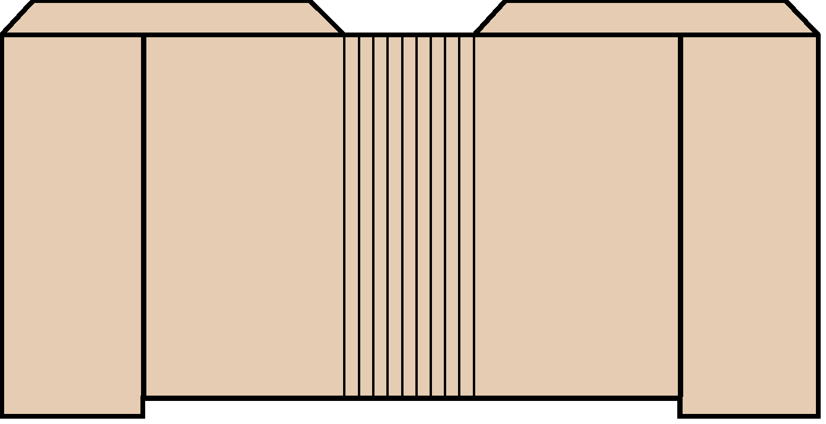



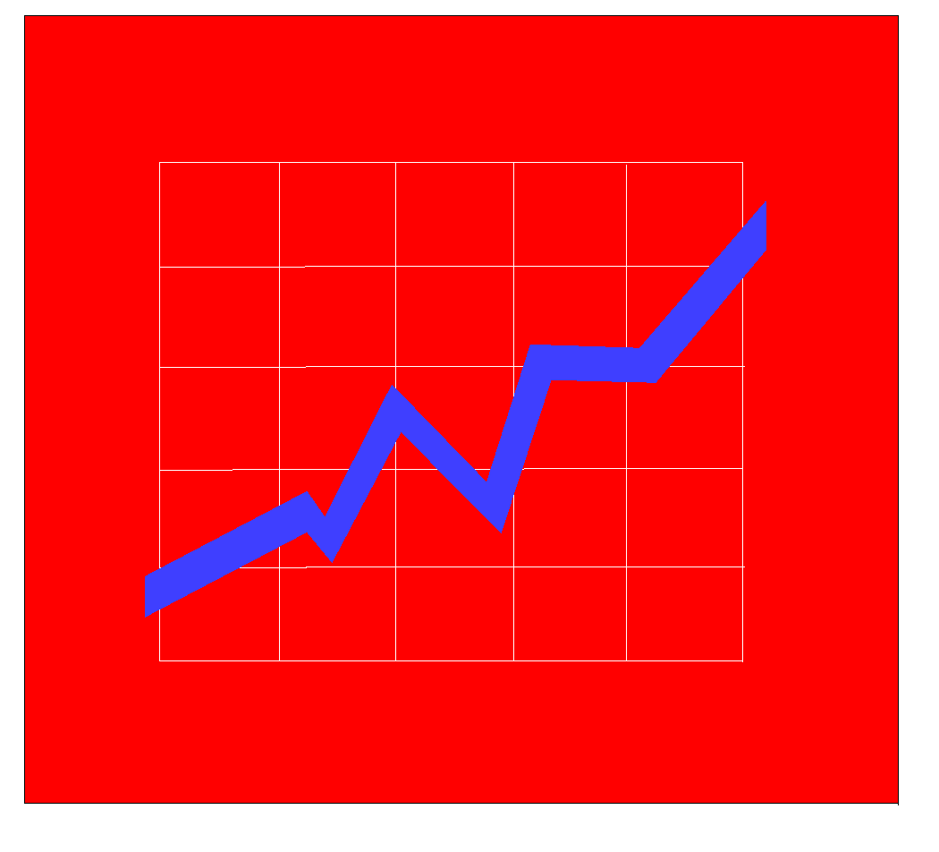
Typical Data Warehouse Architecture
Data
Marts
EIS /DSS
Metadata
Select
Extract
Transform
Integrate
Maintain
Query Tools
Data
Warehouse
OLAP/ROLAP
Web Browsers
Operational
Systems/Data
Middleware/
API
Data
Preparation
Data Mining
Multi-tiered Data Warehouse without ODS
Notes:
‹#›
Here a Typical DW architecture without Operational Data Store is shown:
The various layers of the this architecture are
-Source systems (These are the operational systems which captures the transactions of the Business, this could be any legacy source system/ Mainframe VSAM Files/Flat Files)
-ETL (This component does all data preparation for the Warehouse).
Extraction is the first step in the process of getting data into the data warehouse environment.
Extracting means reading and understanding the source data and copying the data needed for the data warehouse into the staging area for further manipulation.
Once the data is extracted to the staging area, there are numerous potential transformations, such as cleansing the data (correcting misspellings, resolving domain conflicts, dealing with missing elements, or parsing into standard formats), combining data from multiple sources, reduplicating data, and assigning warehouse keys. These transformations are all precursors to loading the data into the data warehouse presentation area.
-Enterprise DW – which captures detailed data for the enterprise. Iit stores data of multiple subject areas such as Customer, Orders etc.
-Metadata. A warehouse needs basic operational metadata, such as procedures on how a data warehouse is used and accessed, procedures on monitoring the growth of the data warehouse relative to the available storage space, and authorizations on who is responsible for and who has access to the data in the data warehouse and data in the operational system.
-Data marts – Data mart contain information from a single department of a business or organization.
-Data Access (EIS/DSS, Query tools, OLAP, web browsers, data mining). This is the presentation area of Data warehouse. Different reporting tools like Business Object, Cognos, Actuate etc. are available in market for reporting purpose.
Data travels from source system to data warehouse to data marts to reports.

Slide 12

Typical Data Warehouse Architecture
Data
Marts
Metadata
Metadata
Select
Extract
Transform
Integrate
Maintain
Select
Extract
Transform
Load
ODS
Data
Warehouse
Operational
Systems/Data
Data
Preparation
Data
Preparation
Multi-tiered Data Warehouse with ODS
Notes:
‹#›
A Typical DW architecture with ODS has following layers.
-Operational source - As we have covered in last slide these are the operational systems which capture the transactions of the Business.
-ETL Layer 1 - This Layer does Extraction from Operational Systems. It then performs transformations like Translating coded values, Selecting only certain columns to load , Encoding free-form values, Deriving a new calculated value and joining data from multiple sources before loading data into Operational Data Store.
-Operation Data Store – This layer stores integrated copies of operational data. ODS as used in this architecture is used when two systems ( OLTP & DW) cannot answer your immediate operational questions.
-ETL Layer 2- This Layer does Extraction from Operational Data Store and then performs transformations like de-duplication, filteretion, sort, join data from multiple sources, Aggregation, Splitting a column into multiple columns and applying any form of simple or complex data validation before loading data into Data Warehouse.
-Metadata Layers -. In this architecture we have two separate Metadata layers. These layers captures Metadata for ODS and EDW respectively.
-Enterprise DW Layer – This layer captures detailed data for the enterprise it stores data of multiple subject areas such as Customer, Orders etc.
-Data marts - Data mart contains information from a single department of a business or organization.
Down stream architecture after data marts remains same as seen in previous slide.
In this Architecture data travels from source system to ODS to data warehouse to data marts and then finally to reports.

Slide 13
Warehouse Components
Its Source Databases – Characteristics & various tools
Notes:
‹#›
While Building a Data Warehouse we use various tools and components at different stages for different purposes.
These components/tools offer a high level of flexibility and scalability for both the Enterprise and the agencies wishing to implement a Business Intelligence solution.
In this section we will cover different Warehouse components/tools & their characteristics.

Slide 14
Warehouse Components
Source Databases
Data extraction/transformation/load (ETL) tool
Data Cleansing tool
Data warehouse maintenance and administration tools
Data modeling tool or interface to external data models
Warehouse databases
End-user data access and analysis tools
Notes:
‹#›
Major data warehouse components are listed here.
-Source Database – Which is operational or legacy system of record whose function it is to capture the transactions of the business
-Data extraction/transformation/load (ETL) tool – Which does data preparation for the Warehouse.
-Data Cleansing tool – This tool is capable of identifying incomplete, incorrect, inaccurate, irrelevant etc. parts of the data and then replacing/modifying/deleting this dirty data.
-Data warehouse maintenance and administration tools – These tools provide ADMIN features like authorize access, monitor access and usage patterns, monitor ad hoc queries, analyze cost structure of queries etc.
-Data modeling tool or interface to external data models – Which Support Data Warehouse design as a modeling technique.
-Warehouse databases – Which capture Technical & Business Metadata of the Warehouse.
-and end-user data access and analysis tools – Which creates user friendly reports for Business User with minimal effort.
We will cover each of them in this section. Let’s start with Source Databases.

Slide 15
Source Databases - Characteristics
Legacy, relational, text or external sources
Designed for high-speed transaction processing
Real-time, current, volatile data
Many short transactions
Update-intensive; modifications by row
Inquiry-oriented; access by keys
High integrity, security, recoverability
Source data is often inconsistent and poorly modeled
Notes:
‹#›
A data source system is the operational or legacy system of record whose function is to capture the transactions of the business. The data in these systems can be in many formats from flat files to hierarchal, and relational RDBMS such as MS Access, Oracle, Sybase, UDB, and IMS to name a few.
Source database characteristics are same as OLTP database characteristics.
The source Database characteristics are,
-This is Legacy, relational, text or external sources data.
-It is designed for high-speed transaction processing.
-It is Real time and volatile data.
-It has many short transactions.
-It is Update intensive and has row level modifications
-Here transaction level inquiry is done e.g. Is the particular medicine is available in stock now?
-This is simple query which is needed to give out some quick info to the user.
-To access the data, primary key is used.
-The data here has high integrity, good security control and is recoverable. A data loss is difficult to recover, so high recoverability is designed.
From data warehouse point of view Source data is often inconsistent, since data warehouse receives data from multiple sources and multiple sources can maintain the data in multiple forms. For e.g. an attribute of employee, can be shown as male, female; m, f; 0,1 etc. one source system may be using male, female while other may be m, f.
Sometimes source data is modeled poorly. This can happen if normalization principles are not followed or after initial design a lot of changes in form of performance related changes come in and accordingly changes are made in database.

Slide 16
Data Extraction, Transformation and Load
Tools (ETL)
Support data extraction, cleansing, aggregation, reorganization, transformation, and load operations
Generate and maintain centralized metadata
Closely integrated with RDBMS
Filter data, convert codes, calculate derived values, map many source data fields to one target data field
Automatic generation of data extract programs
High speed loading of target data warehouses
Employs Middle Ware for near Real Time ETL
Notes:
‹#›
Next is ETL Tool . Data Extraction-Transformation-Load (ETL) tools are used to extract data from data sources, cleanse the data, perform data transformations, and load the target data warehouse and then again to load the data marts. The ETL tool is also used to generate and maintain a central metadata repository and support data warehouse administration. The more robust ETL tools integrate with OLAP tools, data modeling tools and data cleansing tools at the metadata level.
The difference between ETL tool and custom database scripting is that ETL tool can generate and maintain metadata (business and operational) which can be used for impact analysis. Custom database scripting can not maintain metadata.
Few characteristics of an ETL tool are as below
-It supports data extraction, cleansing, aggregation, reorganization, transformation, and load operations. It also supports incremental data load in batch and real time mode.
-It generates and maintain centralized metadata. ETL tools facilitates impact analysis when modifying or enhancing a data warehouse.
-It is closely integrated with RDBMS. Most of the ETL tools provide support for wide range of databases for storing information .
-It filters data, convert codes, calculate derived values, map many source data fields to one target data field.
-It automatically generates data extract programs. Coding with ETL tools using a metadata-driven graphical tool with built-in data cleansing and transformation functions is faster than hand coding.
-It provides high speed loading of target data warehouses. The features like Partitioning & Parallelism available in ETL Tools enable high Speed Extractions and load.
-It employs Middle Ware for near Real Time ETL.

Slide 17
Data Cleaning Tools
To clean data at the source
Clean up source data in-place on the host
Business rule discovery tools which analyze the source data and write cleaning rules based on lexical analysis and AI techniques
ETL tools have limited yet adequate data cleansing functionality
Notes:
‹#›
Data cleansing or data scrubbing is the act of detecting and correcting (or removing) corrupt or inaccurate records from a record set, table , or database. Used mainly in datawarehouse, the term refers to identifying incomplete, incorrect, inaccurate, irrelevant etc. parts of the data and then replacing, modifying or deleting this dirty data.
In the business world, incorrect data can be costly. Many companies use customer information database that record data like contact information, addresses, and preferences. If for instance the addresses are inconsistent, the company will suffer the cost of resending mail or even losing customers.
With clean data, the organization can define effective business strategies and monitor strategy execution.
Data cleaning tools have features such as:
-Clean data at the source
-Clean up source data in-place on the host
- Has business rule discovery tools which analyze the source data and write cleaning rules based on lexical analysis and AI techniques
- ETL tools have limited yet adequate data cleansing functionality. If we have too many Data Quality issues in the source system data the cleansing activity is done using Data Cleansing Tool before loading them into warehouse.
A large variety of tools like Trillium, Data Quality Assistant, DATA CLEANSER are available in the market to aid in data cleansing procedures.

Slide 18
Data Modeling Tools
Support Data Warehouse design as a modeling technique
Support both ER Modeling and Dimensional Modeling
Reverse Engineering and Forward Engineering
Mapping of source data to target data
Data Dictionary
Reporting
Notes:
‹#›
A DWH Environment Involves multiple (i.e. source, staging & target) layers of data storages, Each layer has unique data modeling requirements
A Data Modeling tool Improves productivity among developers when database designs are divided, shared, and reused. It also Ensures consistency, reuse, and integration of enterprise data warehouse.
Data Modeling tool has the features such as:
-Support Data Warehouse design as a modeling technique
-Support both ER Modeling and Dimensional Modeling
-Provide Reverse Engineering and Forward Engineering
1. Reverse Engineering is: Develop physical data model by connecting to the database instance or from database schema
2. Forward Engineering is: As part of development project, develop logical and physical data models.
-Provide Mapping of source data to target data
-Provide Data Dictionary : It contains metadata that describes the data model.
-Provide Reporting : Which is capability to generate report based on data model
Some of the popular tools of Data Modelling are Erwin, Oracle Designer, Power Designer & UML.

Slide 19
Central Metadata
Metadata repository is the foundation of data warehouse. It stores :
Technical metadata
Business metadata
Metadata is stored in the central metadata repository and may be distributed to local metadata repositories
Metadata is generated and maintained by an ETL tool as part of the specification of extraction/transformation/load process
Notes:
‹#›
Metadata describes the information in the data warehouse. It would answer few questions like:
What it means
Where it came from
How it was calculated
When it was loaded
Who owns it
Metadata describes the information about business data, data in all applications / tools, databases and the data warehouse of the organization.
Metadata repository is the foundation of data warehouse. It stores :
Technical metadata - Which is description of data, location, access methods, and data types etc. It is Information about transformation process, audit trail & logs and it can be retrieved from ETL and BI tools repository and database.
Business metadata – Which contains the business rules – maintained by Business Users / IT personnel. Business users are the stake holders of the business Metadata.
It can be retrieved from reporting tools repository.
Metadata is stored in the central metadata repository and may be distributed to local metadata repositories
It is generated and maintained by an ETL tool as part of the specification of extraction/transformation/load process

Slide 20
Warehouse Administration Tools
To set up users, authorize access, monitor access and usage patterns, monitor ad hoc queries, analyze cost structure of queries
To restructure physical database structures to improve performance
To block long queries and reschedule them to run as off-hours batch jobs
Usually packaged with the RDBMS chosen for the data warehouse
Notes:
‹#›
Database administration tool, provided by DW RDBMS, can be used as Warehouse Admin tool.
DW RDBMS vendors have got their own DB admin monitoring tool.
The tool has features such as:
-To set up users, authorize access, monitor access and usage patterns, monitor ad hoc queries, analyze cost structure of queries
-To restructure physical database structures to improve performance
-To block long queries and reschedule them to run as off-hours batch jobs
It is usually packaged with the RDBMS chosen for the data warehouse

Slide 21
Data Access and Analysis Tools
To query the target database, specify reports, and perform OLAP functions
Query Tools
Ad hoc query tools
Managed query tools
OLAP
Desktop OLAP
Relational OLAP
Multidimensional OLAP
Hybrid OLAP
Data Mining Tools
Notes:
‹#›
To query the target database, specify reports, and perform OLAP functions, various tools are available.
The query tools are:
Ad-hoc query tool: With this the query can be developed on the fly. Queries are not pre-defined.
Managed Query tools: This can give Canned report with pre-defined query.
Different types of OLAP tools are:
Desktop OLAP - DOLAP tools provide users with the ability to access multidimensional data using a desktop-focused architecture.
These tools provide users with the ability to have a personal copy of their multidimensional database or provide access to a central data repository from the desktop.
Relational OLAP - ROLAP tools provide a robust set of functions for meta data creation, administration and deployment. The focus of these tools is to provide administrators with the ability to optimize system performance and generate maximum analytical throughput and performance for users. All ROLAP vendors provide the ability to deploy their solutions via the Web or within a multitier client/server environment.
Multidimensional OLAP- MOLAP tools restructure the source data so that it can be accessed, summarized, filtered and retrieved almost instantaneously. As a general rule, MOLAP tools provide a robust solution to data warehousing problems.
Hybrid OLAP- HOLAP is a combination of MOLAP & ROLAP. This architecture has the MOLAP storage of summary data and this summary data has links to the detailed transaction level data in Data Warehouse RDBMS to enable user to drill down to the lowest level of detail. Apart from that it also allows direct access to the data in Data Warehouse, which is not considered worthwhile to be translated into OLAP cubes.
The details for these will be covered in OLAP concepts.
Data Mining tool: Used for pattern extraction identifying the hidden predictive information from large dataset.

Slide 22
Data Warehousing and Web
Benefits
Extends the reach to more users
Data can be shared with external users
Security is a major issue
Client software and management costs go down
Notes:
‹#›
Data warehouse can be accessed thru web. It has benefits like:
1)More users can use it - By surfacing decision support data within a web-based application, users are able to easily view tables, charts, graphs, and documentation associated with the warehouse
2)Enterprise internal as well as external users (agents, customers) can access the DW data –
The Web application like Warehouse Viewer is available in the market which allows users to browse the contents of a warehouse. With Warehouse Viewer, users can access the contents of a warehouse .End users can use their web browsers to locate tables, charts, graphs, and documentation associated with the warehouse. Users are provided both technical and business metadata.
3) No data access client software is required on the user desktop. User can query the DW data over web, so cost of the software goes down.
But the biggest concern is “ security”. Since data travels through Web, it has wider security concern. To overcome this, DW role based security can be implemented. Each person is assigned specific role and according to role they can see segments of data.

Slide 23
Module Summary
Congratulations! You have now completed the 2nd and final part of module of Data Warehouse Concepts.
You should now be able
To Understand What is ODS
To understand to architecture of Warehouse
To understand the Components of Warehouse
Notes:
This course would have helped you understand
What ODS is and how it differs from DWH and OLTP.
Typical Warehouse Architecture with and without ODS
Overview of Different components of Warehouse like Source Databases, ETL tool, Data Cleansing tool, Data warehouse administration tools, Data modeling tool & End-user data access and analysis tools.
This completes my presentation. Its now Quiz time! GOOD LUCK to you. Bye

Slide 24
Quiz
Notes:
© 2009 Wipro Ltd – Internal & Restricted
‹#›

Slide 25
Question 1
What is true about ODS ?
The ODS contains current valued and near current valued data.
The ODS contains current and old data both.
Both A and B are correct.
Both A and B are not correct.
Notes:
© 2009 Wipro Ltd – Internal & Restricted
‹#›

Slide 26
Question 1
What is true about ODS ?
The ODS contains current valued and near current valued data.
The ODS contains current and old data both.
Both A and B are correct.
Both A and B are not correct.
Answer: A
Notes:
© 2009 Wipro Ltd – Internal & Restricted
‹#›

Slide 27
Question 2
Which statements match correctly
OLTP contains current data
ODS contains recent data
Data Warehouse contains historical data
All are correct
Notes:
© 2009 Wipro Ltd – Internal & Restricted
‹#›

Slide 28
Question 2
Which statements match correctly
OLTP contains current data
ODS contains recent data
Data Warehouse contains historical data
All are correct
Answer: D
Notes:
© 2009 Wipro Ltd – Internal & Restricted
‹#›

Slide 29
Question 3
What is correct about Data Warehouse components ?
It has Data sources
It has ETL tool
It has Data cleansing tools
All are correct
Notes:
© 2009 Wipro Ltd – Internal & Restricted
‹#›

Slide 30
Question 3
What is correct about Data Warehouse components ?
It has Data sources
It has ETL tool
It has Data cleansing tools
All are correct
Answer: D
Notes:
© 2009 Wipro Ltd – Internal & Restricted
‹#›

Slide 31
Question 4
Which is not correct about Data Modeling tool ?
Support data warehouse design as a modeling technique
It should support ER Modeling as well as Dimension Modeling technique
It provides data extraction tool
None is correct
Notes:
© 2009 Wipro Ltd – Internal & Restricted
‹#›

Slide 32
Question 4
Which is not correct about Data Modeling tool ?
Support data warehouse design as a modeling technique
It should support ER Modeling as well as Dimension Modeling technique
It provides data extraction tool
None is correct
Answer: C
Notes:
© 2009 Wipro Ltd – Internal & Restricted
‹#›

Slide 33
Question 5
What is not a correct option for data access and analysis tool ?
Query tool
OLAP
Data mining tool
Erwin Data Modeler
Notes:
© 2009 Wipro Ltd – Internal & Restricted
‹#›

Slide 34
Question 5
What is not a correct option for data access and analysis tool ?
Query tool
OLAP
Data mining tool
Erwin Data Modeler
Answer: D
Notes:
© 2009 Wipro Ltd – Internal & Restricted
‹#›

Slide 35
References
Notes:
© 2009 Wipro Ltd – Internal & Restricted
‹#›

Slide 36
References
Publications
Courses
The Data Warehouse Toolkit by Ralph Kimball, Margy Ross from Wiley Publication
DM 101 Data Model Concepts
OLAP Concepts
URL’s
Training Programs
www.learndatamodeling.com

Slide 37
Thank You
ANAND KUMAR
Project Leader
Anand.akumar@wipro.com

